Slide 1


American House Pricing: Reproducing from Python to R
We will explore the dynamic American real estate market and try to provide house price predictions using R programming language. By leveraging R's advanced analytical capabilities, we aim to obtain valuable insights and identify factors affecting house prices.
Oybek Ismatov - 436651
Gadir Gasimov - 436852
Fuad Shabanov - 428246

Slide 2
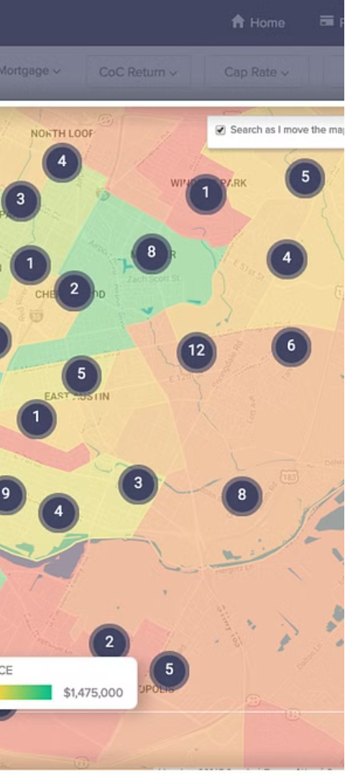
Introduction
1
Why We Chose the Subject
2
Reproducing to R
Economic Indicator
Investment Analysis
Wealth Distribution
Consumer Spending
Language Flexibility
Learning Opportunity
Validation of Results
Tool Diversity

Slide 3
Problem Statement and Approach
Problem Statement
Approach
Our previous year's machine learning project focused on predicting American house prices using Python.
To ensure the project's relevance, we plan to update the data and methodology using the R programming language
We will load the new dataset into R and apply the same preprocessing steps used in Python to ensure consistency.
Model training, cross-validation, and evaluation will be conducted using R packages to assess the model's robustness on unseen

Slide 4
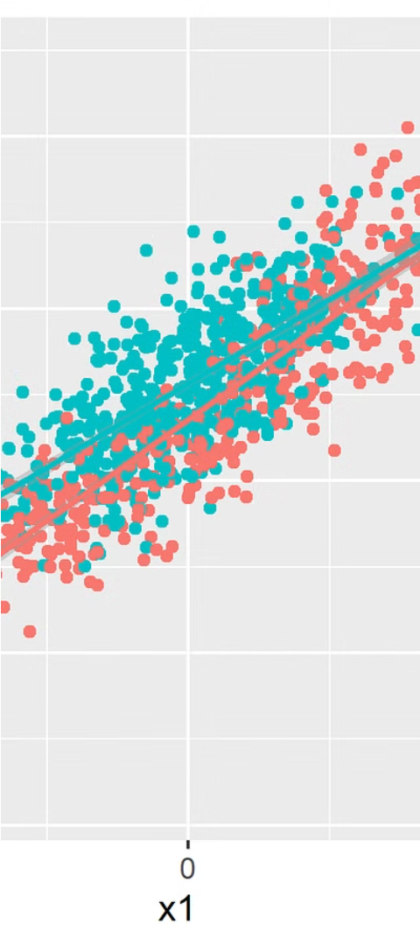
Tools and Technologies
R Programming Language
Specific R Packages
Data Manipulation: We'll utilize the tidy verse package for efficient data manipulation and transformation.
Visualization: ggplot2 will be used for creating insightful visualizations to explore trends and patterns in the data.
Machine Learning: caret package will facilitate model training, tuning, and evaluation with ease.
R offers extensive support for statistical analysis, data manipulation, visualization, and machine learning.
Its rich ecosystem of packages makes it a preferred choice for data scientists and analysts.

Slide 5




Team Member Responsibilities
Oybek Ismatov
Role: Responsible for data preprocessing and cleaning in R.
Responsibilities: Loading the new dataset, applying preprocessing steps, ensuring data quality and consistency.
Gadir Gasimov
Role: Leads model training and evaluation.
Responsibilities: Utilizing R packages for model training, cross-validation, and assessing model performance
Fuad Shabanov
Role: Focuses on project coordination and documentation.
Responsibilities: Facilitating communication among team members, documenting project progress, and findings.

Slide 6
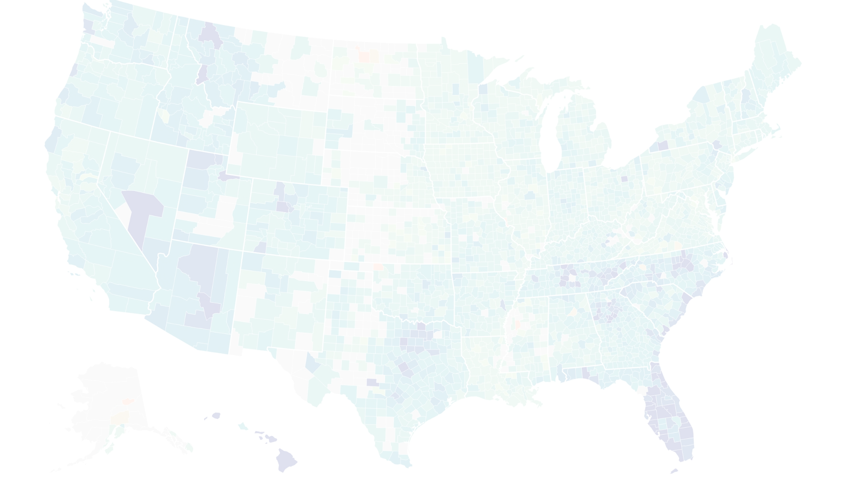
Conclusion
Recap of Key Points
1
Summarize the rationale behind the project, our approach, the tools we'll use, and team member responsibilities.
2
Next Steps
Outline the project timeline, including data conversion, model training, evaluation, and documentation.
Emphasize the importance of collaboration and effective communication among team members
Open for Questions
3
We welcome any questions or feedback from the audience to help us refine and strengthen our project.

